Slide 1

Book Sharing Application
Final Presentation
TEAM 7 – Jira's Nightmare

Slide 2

Agenda
Application’s description
Scrum Team 7 members
Atf structure
Features presentation
Performance testing
Conclusions and recommendations
Upcoming features
Q&A
Notes:
Agenda
General Template Guidance: Information to help you make good presentations.
Standard / Static Slides: Some key Endava slides/lockups that, in general, should only be modified by marketing.
Template Slides: A selection of template slides for use in Endava presentations.
Larger Format Template Slides: Template slides with larger content.
Icon Library: A selection of hundreds of icons to use in Endava presentations.

Slide 3

1
Application’s description
Endava Book Sharing
Notes:
Chapter Intro Slide (version H)
This slide should be used at the beginning of each “chapter” of your presentation (as introduced in the Agenda slide) to keep the audience aware of their place in the story and to help break things up. Change the text and chapter number accordingly. If you do not need a sub-head (the smaller text), delete it. Use different backgrounds for different chapter titles, try not to repeat a background.
Very short presentations (< ~10 slides) may not need Chapter Intro Slides.
There are multiple versions of this template with various white and black background images starting on slide 10.

Slide 4


Book Sharing Application - 1. Endava Book Sharing
dsgdfghgjf
Application’s Description
Book Sharing
The only one thing that could replace a book, is the next book. Based on this idea, we developed the Book Sharing application, a way to help book lovers to share not only the books themselves, but also opinions and emotions about the book they’ve just read.
Book Sharing it's a web library where users can share and borrow paper books.
A user can make an account, upload books that he wants to share, take a book to read for 2 weeks. Also, to
write a review and rate the book that he read, reserve a book and add it to the wish list.
If he deleted his account or forgot the credentials, it can be restored.
This project can be implemented in schools, universities or companies to popularize reading of paper books
and help people interact, communicate and organize free time activities.
web library application
Notes:
Presentation Matters
This slide provides justification for caring about how your presentations look and feel.
It can also be used as a template slide. Change the header (and footer) to reflect the client, presentation name, and chapter title. To change the header and footer, click “edit master” and change the header and footer on all the master slides to have the same client and presentation name across all pages.

Slide 5
2
Scrum team 7 members
Jira’s Nightmare
Notes:
Chapter Intro Slide (version F)
This slide should be used at the beginning of each “chapter” of your presentation (as introduced in the Agenda slide) to keep the audience aware of their place in the story and to help break things up. Change the text and chapter number accordingly. If you do not need a sub-head (the smaller text), delete it. Use different backgrounds for different chapter titles, try not to repeat a background.
Very short presentations (< ~10 slides) may not need Chapter Intro Slides.
There are multiple versions of this template with various white and black background images starting on slide 10.

Slide 6




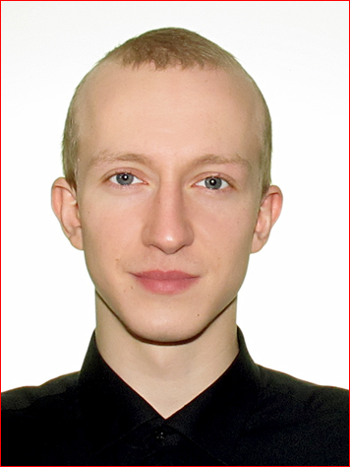



Book Sharing Application - 2. Jira’s Nightmare
Gheorghii Mosin
Scrum Master
gheorgii.mosin@endava.com
Gherman Ciub
AUtomation Intern
gherman.ciub@endava.com
Ecaterina Tabac
Performance intern
ecaterina.tabac@endava.com
Sergiu Grosu
Automation intern
sergiu.grosu@endava.com
Dmitri Carapunarli
automation intern
dmitri.carapunarli@endava.com
Alexei Diaconu
Performance intern
alexei.diaconu@endava.com
Victor Jardan
Automation intern
victor.jardan@endava.com
Notes:
Team / Introductions
This slide should be edited to include relevant photos, names, roles, and contact information.
This slide can also be used as an “introductions” slide to help introduce meeting participants at the beginning of the deck.

Slide 7
3
ATF Structure
Notes:
Template Slides
A selection of template slides for use in Endava presentations.

Slide 8
ATF STRUCTURE
log4j2.xml
screenshots
WebDrivers
resources
logs
BitBucket Repo
APIOnly
src
test
properties
features
SeleniumOnly
pom.xml
main
java
manualOnly
resources
ATFCore
java
ContextCore
RestCore
Utils
CucumberCore
SeleniumCore
context
pages
Actions
LoggersCore
Hooks
Steps

Slide 9
4
Automation testing
Features Presentation
Notes:
Chapter Intro Slide (version B)
This slide should be used at the beginning of each “chapter” of your presentation (as introduced in the Agenda slide) to keep the audience aware of their place in the story and to help break things up. Change the text and chapter number accordingly. If you do not need a sub-head (the smaller text), delete it. Use different backgrounds for different chapter titles, try not to repeat a background.
Very short presentations (< ~10 slides) may not need Chapter Intro Slides.
There are multiple versions of this template with various white and black background images starting on slide 10.

Slide 10


Book Sharing application - 4. Features Presentation
User registration
This user story brings the registration functionality for new users. The registration page has 5 fields that had to be tested according to the Acceptance Criteria. Also, the password has to be encrypted after user is registered.
USER LOGIN
What comes after registration? Right, logging in. This user story brings the login functionality that had to be tested according to the Acceptance Criteria.
Book wish list
Adding a book to a wish list is a must have. This functionality allows users to request books to be added into the system.
Gherman Ciub
Automation Testing Intern
Notes:
Standard text slide (version 9)
Varying the length of the paragraphs as well as using bulleted and numeric lists help with keeping the reader engaged.
Lists help to “skim” the information on the page and allow the audience to absorb a just the key information.

Slide 11
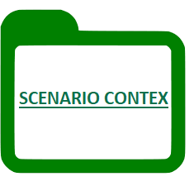

Book Sharing application - 4. Features Presentation
Book Sharing Home Page
A registered user can see on the main page the list of all books added, arranged in pages 3x4. He will be able to filter them using different criteria: Author, Genre, Language, Status, Rating
Book assignment
A registered user can assign a book to himself and get access to it for a set period
Admin Page: Delete Reviews
The Admin can moderate reviews, as some users might post something useless, offensive or harmful
Victor Jardan
Automation Testing Intern
Notes:
Standard text slide (version 9)
Varying the length of the paragraphs as well as using bulleted and numeric lists help with keeping the reader engaged.
Lists help to “skim” the information on the page and allow the audience to absorb a just the key information.

Slide 12

Book Sharing application - 4. Features Presentation
Add new book future
A registered User can see the list of all books added. When User accesses his profile, he will be able to add a new book after filling up mandatory fields.
Add missing author feature
System Administrator can add a new author, when he clicks the administrator page on the panel menu. He can add a new author or make some changes on author's first name or last name, if a user added a new author with mistakes.
Book rating and feedback future
Any Application User can add feedback to a book. He also can rate a book (from 1 to 5 stars). His feedback will be displayed on top of the feedbacks list, all others will be located closer.
Dmitri Carapunarli
Automation Testing Intern
Notes:
Standard text slide (version 9)
Varying the length of the paragraphs as well as using bulleted and numeric lists help with keeping the reader engaged.
Lists help to “skim” the information on the page and allow the audience to absorb a just the key information.

Slide 13

Book Sharing application - 4. Features Presentation
CRUD Book page
CRUD is an acronym that comes from the world of computer programming and refers to the four functions that are considered necessary to implement a persistent storage application: create, read, update and delete.
BOOK queue
Functional that gives user possibility to get access to the book for a set period in the future. The number of pending books in the user's possession is less than 1, if user tries to add another book to queue the button will be disabled.
Manage application roles
Admin has possibility to assign or delete 'Admin' role to the existing users in the system. Admin has details table where he can manage users Role manipulations. Role can be removed or assigned from this menu.
Sergiu Grosu
Automation Testing Intern
Notes:
Standard text slide (version 9)
Varying the length of the paragraphs as well as using bulleted and numeric lists help with keeping the reader engaged.
Lists help to “skim” the information on the page and allow the audience to absorb a just the key information.

Slide 14
5
Performance Testing
Performance Testing Report
Notes:
Chapter Intro Slide (version C)
This slide should be used at the beginning of each “chapter” of your presentation (as introduced in the Agenda slide) to keep the audience aware of their place in the story and to help break things up. Change the text and chapter number accordingly. If you do not need a sub-head (the smaller text), delete it. Use different backgrounds for different chapter titles, try not to repeat a background.
Very short presentations (< ~10 slides) may not need Chapter Intro Slides.
There are multiple versions of this template with various white and black background images starting on slide 10.

Slide 15
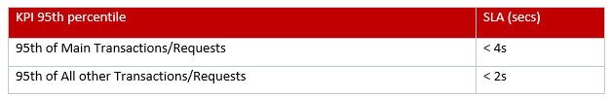
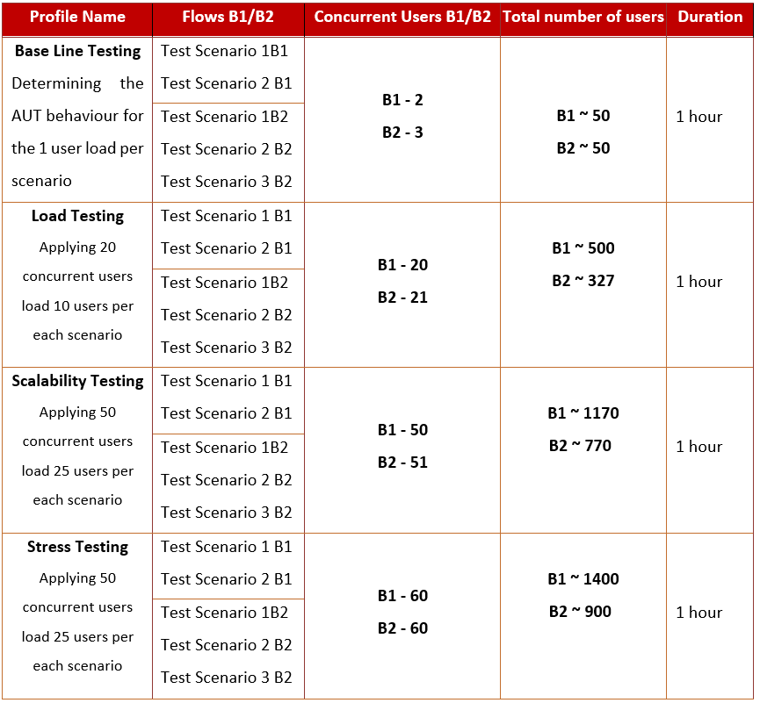
Book Sharing Application - 5.Performance Testing Report
Performance Testing Strategy
Tested functionality: In Build 1 - register, log in, log out, catalog, personal profile, book page, assign a book, add a book to queue
In Build 2: restore account, extend assignment, add a review, add a wanted book
Application Response Times (SLA):
NFR:
20 concurrent users in pick hours
Scalable to 50 concurrent users in pick hours
Book Sharing
Notes:
Standard text slide (version 6)
Creating contrast throughout the presentation can help to call attention to key ideas.
They can also create visual “breaks” in the cadence of the presentation and allow the eye to rest on big ideas.
The quotes should be important information, quotes, or Endava marketing messages.

Slide 16
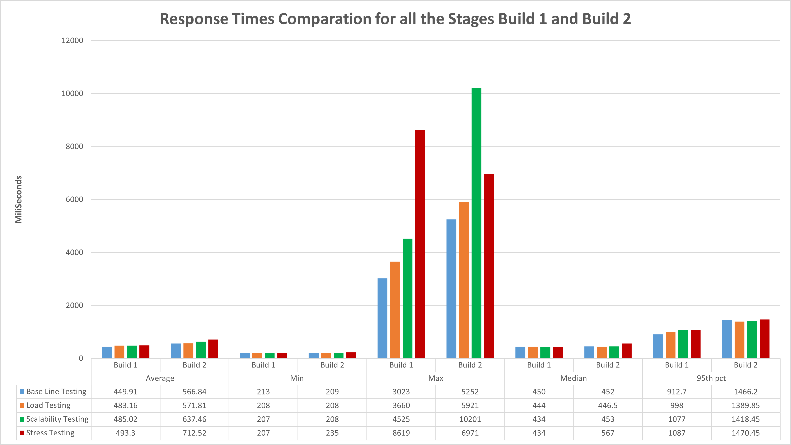
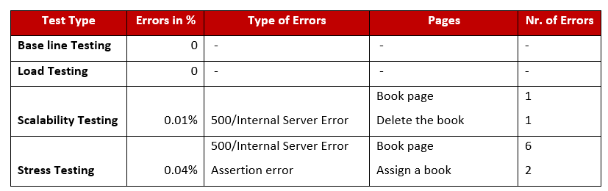
Book Sharing Application - 5.Performance Testing Report
Performance Testing Results
BUILD 1 & 2
Notes:
Standard text slide (version 6)
Creating contrast throughout the presentation can help to call attention to key ideas.
They can also create visual “breaks” in the cadence of the presentation and allow the eye to rest on big ideas.
The quotes should be important information, quotes, or Endava marketing messages.

Slide 17
6
Conclusions and Recommendations
Notes:
Chapter Intro Slide (version D)
This slide should be used at the beginning of each “chapter” of your presentation (as introduced in the Agenda slide) to keep the audience aware of their place in the story and to help break things up. Change the text and chapter number accordingly. If you do not need a sub-head (the smaller text), delete it. Use different backgrounds for different chapter titles, try not to repeat a background.
Very short presentations (< ~10 slides) may not need Chapter Intro Slides.
There are multiple versions of this template with various white and black background images starting on slide 10.

Slide 18
Book Sharing Application - 6. Conclusions & Recommendations
Build 1
Build 2
The response time of the application in Build 1 was in the desired limits
The variation of response time for 95th pct between all stages constitutes no more than 20%
The dynamic of the transactions grew according to the load, and during the tests there were not any spikes or sudden falls
The app have faced the load, including stress test
NFR were met, under all loads the application had a reliable performance and good rendering times
The applied loads did not affect the memory, but a higher load applied could substantially increase the ram usage
Requests with big quantity of data that called the data base had the slowest response times and fails during execution
The response times in Build 2 grew, but almost for all 95th pct it was according to NFR
The application is scalable to 50 concurrent users
The app had very good results in Stress Testing
The applied loads did not affect the resources usage
The Max response time was in Scalability Load, with 10 sec, for Delete a book request
The slowest request were, that invoked information from the Data Base
The dynamic of the transactions grew according to the load, and during the tests there were not any spikes or sudden falls
Conclusions
Notes:
Concept slide (version 1)
Concept slides create “breathing room” in presentations by having white space and focusing on a few key details.
They are intended to represent important information, quotes, or Endava marketing messages to the audience.

Slide 19
Book Sharing Application - 6. Conclusions & Recommendations
Recommendations for Build 1 & 2
Refactor the code and increase the performance of the main pages
Deploy on the server the css/js scripts to get faster responses
Optimize failed request
Use a load generator high physical resources to avoid any bottlenecks when applying higher user loads
A network with larger bandwidth should be considered for higher loads
Track old users and data to monitor how they are managed and stored in the Data Base
Add RAM to Data Base Server
Sql profiling should be considered in order to verify the resource consumption of the queries
Book Sharing
Notes:
Standard text slide (version 6)
Creating contrast throughout the presentation can help to call attention to key ideas.
They can also create visual “breaks” in the cadence of the presentation and allow the eye to rest on big ideas.
The quotes should be important information, quotes, or Endava marketing messages.

Slide 20
7
Upcoming Features
Notes:
Chapter Intro Slide (version D)
This slide should be used at the beginning of each “chapter” of your presentation (as introduced in the Agenda slide) to keep the audience aware of their place in the story and to help break things up. Change the text and chapter number accordingly. If you do not need a sub-head (the smaller text), delete it. Use different backgrounds for different chapter titles, try not to repeat a background.
Very short presentations (< ~10 slides) may not need Chapter Intro Slides.
There are multiple versions of this template with various white and black background images starting on slide 10.

Slide 21



Book Sharing application - 7. Upcoming features
Upcoming Features:
Upload electronic books
Offline Book club
Integrated online events
Users can upload electronic version of books and share them
Create a book club where to organize offline meeting to discuss
Organize meetings with invited authors and discuss new published books
Extend the club and meetings in an online format
Integrate an organization’s online calendar
Notes:
Elements (version 4)
Elements are used to give more detail to a set of ideas, they should all relate to the same topic.
Use this page for a list of deliverables, key roles on a project, phases of a project, or any topic that can be broken down into more specific examples.
Each section should have an icon that relates to the content of that specific element, no icon should be repeated on the same page, and they should all be the same colour.
Use this version when there are less examples to breakdown with more text associated with the element.

Slide 22

Q&A?
TEAM 7 – Jira’s Nightmare

